Slide 1
The Big Picture
Chapter 3

Slide 2
Examining Computational Problems
We want to examine a given computational problem and see how difficult it is.
Then we need to compare problems
Problems appear different
We want to cast them into the same kind of problem
  decision problems
  in particular, language recognition problem

Slide 3
Decision Problems
A decision problem is simply a problem for which the answer is yes or no (True or False). A decision procedure answers a decision problem.
Examples:
• Given an integer n, does n have a pair of consecutive
integers as factors?
• The language recognition problem: Given a
language L and a string w, is w in L?
Our focus

Slide 4
The Power of Encoding
For problem already stated as decision problems.
  encode the inputs as strings and then define a language that contains exactly the set of inputs for which the desired answer is yes.
For other problems, must first reformulate the problem as a decision problem, then encode it as a language recognition task

Slide 5
Everything is a String
Pattern matching on the web:
• Problem: Given a search string w and a web
document d, do they match? In other words,
should a search engine, on input w, consider
returning d?
• The language to be decided: {<w, d> : d is a
candidate match for the query w}

Slide 6
Everything is a String
Does a program always halt?
• Problem: Given a program p, written in some
some standard programming language, is p
guaranteed to halt on all inputs?
• The language to be decided:
HP_{ALL} = {p : p halts on all inputs}

Slide 7
Everything is a String
What If we’re not working with strings?
Anything can be encoded as a string.
<X> is the string encoding of X.
<X, Y> is the string encoding of the pair X, Y.

Slide 8
Everything is a String
Primality Testing
• Problem: Given a nonnegative integer n, is it
prime?
• An instance of the problem: Is 9 prime?
• To encode the problem we need a way to encode
each instance: We encode each nonnegative
integer as a binary string.
• The language to be decided:
PRIMES = {w : w is the binary encoding of
a prime number}.

Slide 9
Everything is a String
• Problem: Given an undirected graph G, is it connected?
• Instance of the problem:
1 2 3
4 5
• Encoding of the problem: Let V be a set of binary numbers, one for
each vertex in G. Then we construct ⟨G⟩ as follows:
• Write |V| as a binary number,
• Write a list of edges,
• Separate all such binary numbers by “/”.
101/1/10/10/11/1/100/10/101
• The language to be decided: CONNECTED = {w ∈ {0, 1, /}* : w =
n₁/n₂/…n_{i}, where each n_{i} is a binary string and w encodes a
connected graph, as described above}.

Slide 10
Turning Problems Into Decision Problems
Casting multiplication as decision:
• Problem: Given two nonnegative integers,
compute their product.
• Reformulation: Transform computing into verification.
• The language to be decided:
L = {w of the form:
<integer₁>x<integer₂>=<integer₃>, where:
<integer_{n}> is any well formed integer, and
integer₃ = integer₁ ∗ integer₂}
12x9=108
12=12
12x8=108

Slide 11
Turning Problems Into Decision Problems
Casting sorting as decision:
• Problem: Given a list of integers, sort it.
• Reformulation: Transform the sorting
problem into one of examining a pair of lists.
• The language to be decided:
L = {w₁ # w₂: ∃n ≥1
(w₁ is of the form <int₁, int₂, … int_{n}>,
w₂ is of the form <int₁, int₂, … int_{n}>, and
w₂ contains the same objects as w₁ and
w₂ is sorted)}
Examples:
1,5,3,9,6#1,3,5,6,9
1,5,3,9,6#1,2,3,4,5,6,7
Notes:
First in, second not in

Slide 12
Turning Problems Into Decision Problems
Casting database querying as decision:
• Problem: Given a database and a query, execute the query.
• Reformulation: Transform the query execution problem
into evaluating a reply for correctness.
• The language to be decided:
L = {d # q # a:
d is an encoding of a database,
q is a string representing a query, and
a is the correct result of applying q to d}
Example:
(name, age, phone), (John, 23, 567-1234)
(Mary, 24, 234-9876)#(select name age=23)#
(John)
Notes:
∈ L

Slide 13
The Traditional Problems and their Language Formulations are Equivalent
By equivalent we mean that either problem can be reduced to the other.
If we have a machine to solve one, we can use it to build a machine to do the other using just the starting machine and other functions that can be built using a machine of equal or lesser power.

Slide 14
An Example
Consider the multiplication example:
L = {w of the form:
<integer₁>x<integer₂>=<integer₃>, where:
<integer_{n}> is any well formed integer, and
integer₃ = integer₁ ∗ integer₂}
Given a multiplication machine, we can build the language recognition machine:
Given the language recognition machine, we can build a multiplication machine:

Slide 15
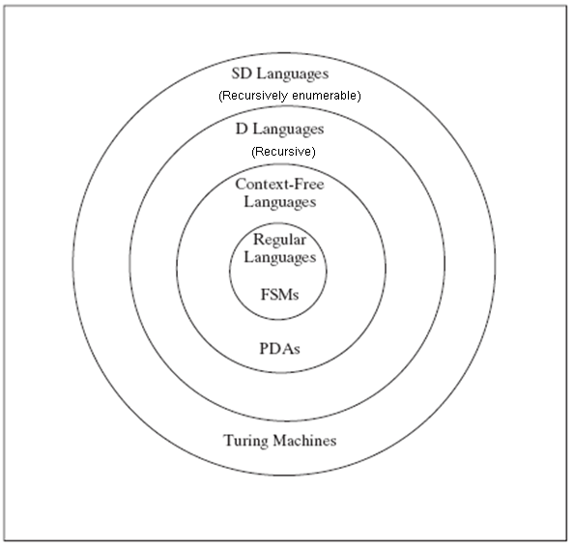
Languages and Machines

Slide 16
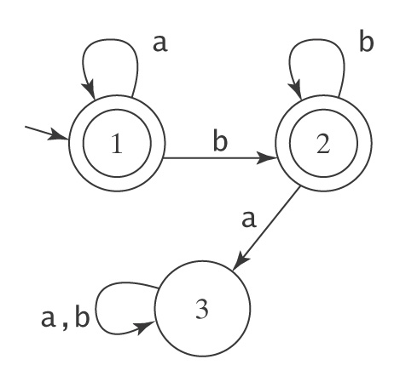
Finite State Machines
An FSM to accept a*b*:
We call the class of languages acceptable by some FSM regular
There are simple useful languages that are not regular:
  An FSM to accept A^{n}B^{n} = {a^{n}b^{n} : n ≥ 0}
  How can we compare numbers of a’s and b’s?
  The only memory in an FSM is in the states and we must choose a fixed number of states in building it. But no bound on number of a’s

Slide 17
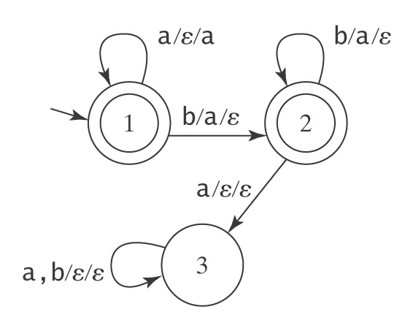
Pushdown Automata
Build a PDA (FSM + a single stack)
to accept A^{n}B^{n} = {a^{n}b^{n} : n ≥ 0}
Example: aaabb
Stack:

Slide 18
Another Example
Bal, the language of balanced parentheses
  contains strings like (()) or ()(), but not ()))(
  important, almost all programming languages allow parentheses, need checking
  PDA can do the trick, not FSM
We call the class of languages acceptable by some PDA context-free.
There are useful languages not context free.
  A^{n}B^{n}C^{n} = {a^{n}b^{n}c^{n} : n ≥ 0}
  a stack wouldn’t work. All popped out and get empty after counting b

Slide 19
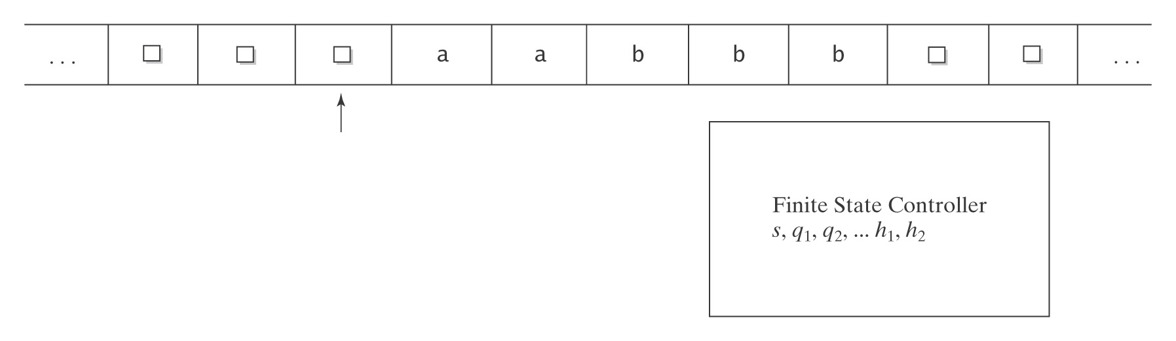
Turing Machines
A Turing Machine to accept A^{n}B^{n}C^{n}:

Slide 20
Turing Machines
FSMs and PDAs are guaranteed to halt. Not Turing machine
Now use Turing machine to define two new classes of languages
A language L is decidable (computable) iff there exists a Turing machine M that halts on all inputs, accepts all strings that are in L, and rejects all strings that are not in L.
  in other words, M can always say yes or no properly
A language L is semidecidable iff there exists a Turing machine M that accepts all strings in L and fails to accept every string not in L. Given a string not in L, M may reject or it may loop forever.
  in other words, M can always say yes properly, but not no.
    give up looking? say no?
  every decidable language is also semidecidable, not vice versa
Bal, A^{n}B^{n}, A^{n}B^{n}C^{n} … are all decidable
semidecidable but not decidable:
{<p,w>: p is a Java program that halts on input w}

Slide 21
Languages and Machines
Hierarchy of language classes
Rule of Least Power: “Use the least powerful language suitable for expressing information, constraints or programs on the World Wide Web.”
Applies far more broadly.
Expressiveness generally comes at a price
  computational efficiency, decidability, clarity

Slide 22
Grammars, Languages, and Machines
Generates
Language
Grammar
Recognizes
Machine

Slide 23
A Tractability Hierarchy
P : contains languages that can be decided in polynomial time
NP : contains languages that can be decided by a nondeterministic machine (one can conduct a search by guessing which move to make) in polynomial time
PSPACE: contains languages that can be decided by a machine with polynomial space
P = NP ? Biggest open question for theoretists
P ⊆ NP ⊆ PSPACE

